Slide 1
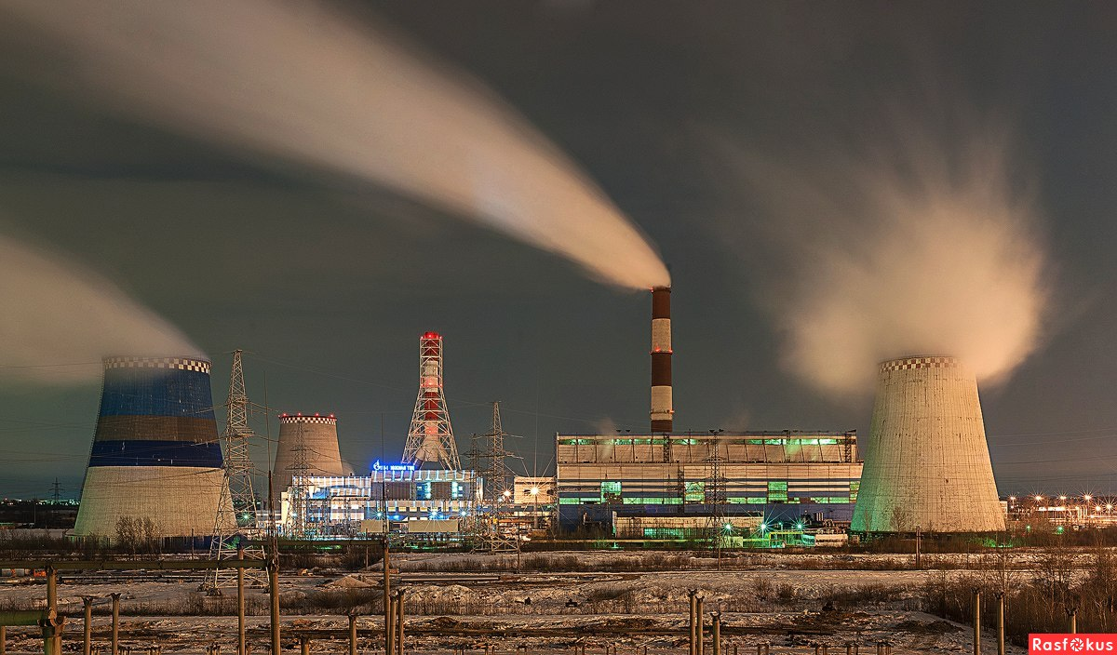
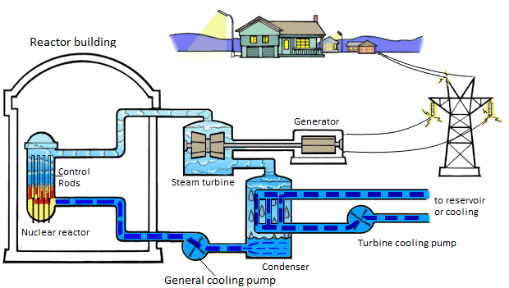
INVESTMENT DESIGN INNOVATION IN THE ENERGY SYSTEM
13.5 Boiling water reactors (BWR)
The principle of operation of the power unit on the example of the reactor of the Fukushima – 1
For stable operation of a BWR hull reactor, a mode is chosen in which the steam volume does not exceed a certain value. At large values of the steam volume, the operation of the reactor can be unstable.
Reducing the power reduces the boiling intensity, after which the reactor power and the boiling intensity begin to increase. There is a dangerous fluctuation in power.
When the vapor content is below the permissible level, such dangerous power fluctuations do not occur, the reactor self-regulates, providing a stationary mode of operation.
Therefore, the permissible volume of steam below which the stable operation of the BWR reactor is ensured limits the power of the reactor with the specified core size.

Slide 2
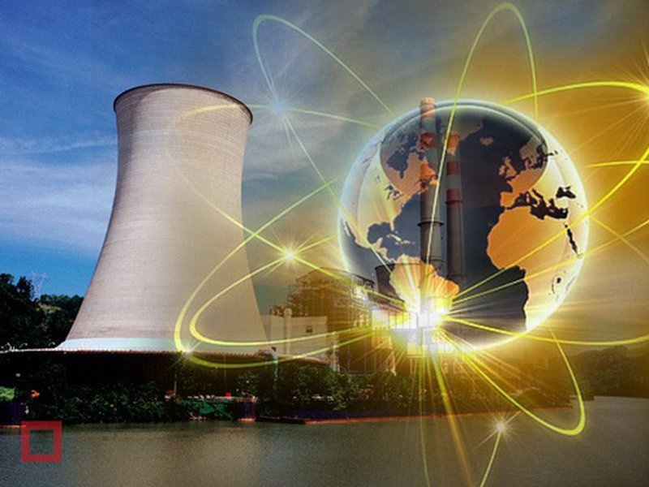
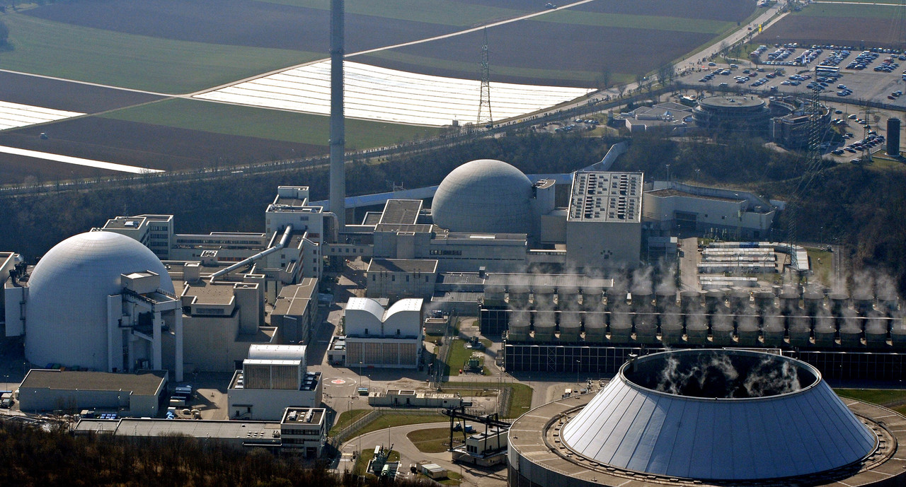
Tutorial 13. ENERGY INVESTMENT OBJECTS
Part 2. Nuclear energy
INVESTMENT DESIGN INNOVATION IN
THE ENERGY SYSTEM
BWR. Outside
Advantages and disadvantages
The main advantage is the practical independence from fuel sources due to the small amount of fuel used.
A huge advantage of the nuclear power plant is its relative environmental cleanliness. So, coal power plants, equal in nuclear capacity, throwing for 50 years, the amount of radioactive waste is equal to the volume of spent fuel during the same period, subject to disposal; i.e. coal plant gives more specific (per unit of electricity produced) the release of radioactive substances.
The only factor in which nuclear power plants are inferior in environmental terms to traditional CHPP is thermal pollution caused by high consumption of process water for cooling turbines, which is compensated by NTPP, artificial reservoirs (fish farming, oyster farming, greenhouse heating) or modern cooling towers. All this also makes it possible to obtain an efficiency similar to that of a CHPP.
The cost of building a nuclear power plant is about the same level as the construction of a thermal power plant, or slightly higher.
The main drawback of nuclear power plants is the severe consequences of accidents.
A serious problem for nuclear power plants is their elimination after the resource is exhausted, according to estimates, it can amount to up to 20 % of the cost of their construction.
For a number of technical reasons, it is highly undesirable for nuclear power plants to operate in maneuverable modes, that is, to cover the variable part of the electrical load schedule.
Cumulative coefficient (installed capacity utilization factor) for all operating power units: high-power channel reactor HPCR -69.71 %; WWER – 71.54 %.

Slide 3
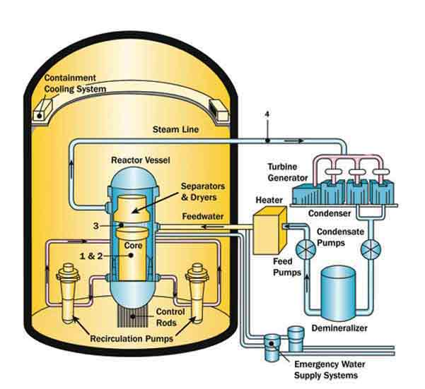
Tutorial 13. ENERGY INVESTMENT OBJECTS
Part 2. Nuclear energy
INVESTMENT DESIGN INNOVATION IN
THE ENERGY SYSTEM

Slide 4
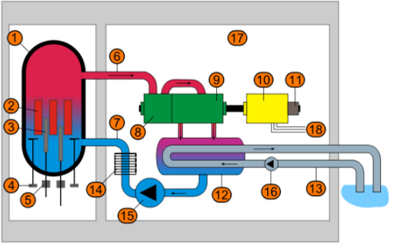
Tutorial 13. ENERGY INVESTMENT OBJECTS
Part 2. Nuclear energy
INVESTMENT DESIGN INNOVATION IN
THE ENERGY SYSTEM
A typical scheme of a commercial boiling water reactor (1). The reactor core creates a high temperature, (2) a steam-water mixture that is produced from distilled water (the reactor coolant).The mixture moves upward through the core, absorbing heat, from the separator (3) in which the moisture drops are removed and through the steam line (4) the steam enters the main turbine.
The turbine is connected to a generator that generates electricity. After the turbine, the steam condenses into the liquid phase (water) and enters the demineralizer, where the water is purified. After the demineralizer, the water returns to the reactor core. The reactor core contains fuel cells, which are cooled by water supplied to the assemblies by a pump. These pumps and other operating systems are powered by the electricity. If the recator coolant supply is cut off as a result of an accident, emergency cooling is supplied to the reactor from other pumps that can be powered by diesel generators. Other security systems also need electricity. WBR reactors contain from 370-800 fuel assemblies.

Slide 5
INVESTMENT DESIGN INNOVATION IN THE ENERGY SYSTEM
13.6 HPCR - High-Power Channel Reactor (LGWR by IAEA)
HPCR - High-Power Channel Reactor (LGWR by IAEA) is a series of power nuclear reactors developed in the Soviet Union. This reactor is a channel, heterogeneous, uranium – graphite (graphite-water moderator), boiling type, with thermal neutrons; it is designed to produce saturated steam at a pressure of 70 kgf/cm2. The heat carrier is boiling water. Due to their size, they are usually the most visible part of a nuclear power plant.
The main feature of this reactor is the absence of a hull.
HPCR-1000
The core of HPCR-1000 core consists of a graphite cylinder with a height of 7 m and a diameter of 11.8 m, composed of smaller blocks, which acts as a moderator. Graphite is riddled with a large number of vertical holes, through each of which passes a pressure pipe (also called a process channel (process channel)). The central part of the pressure pipe located in the core is made of an alloy of zirconium with niobium (Zr + 2.5 % Nb (niobium)), which has high mechanical and corrosion properties, the upper and lower parts of the pressure pipe are made of stainless steel. The zirconium and steel parts of the pressure pipe are connected by welded adapters.

Slide 6
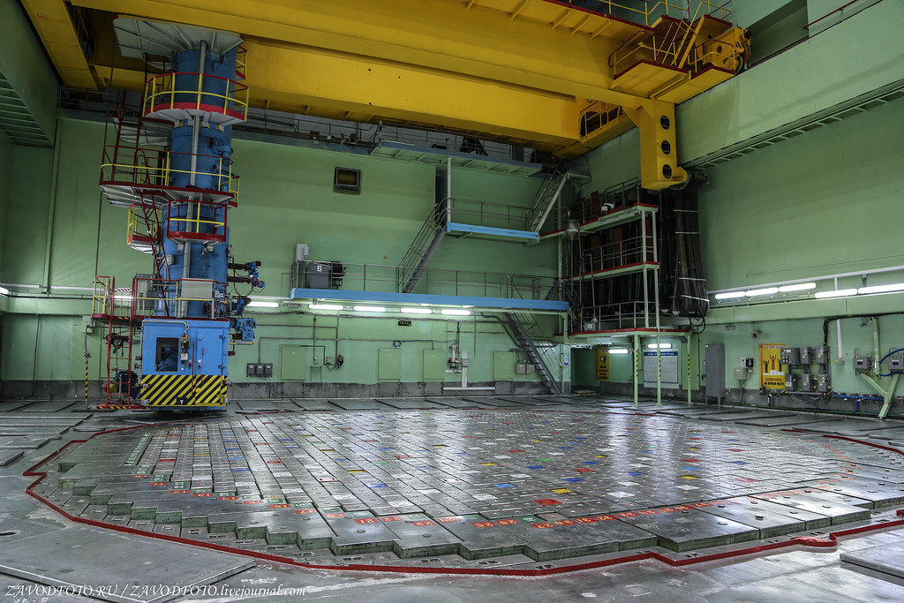
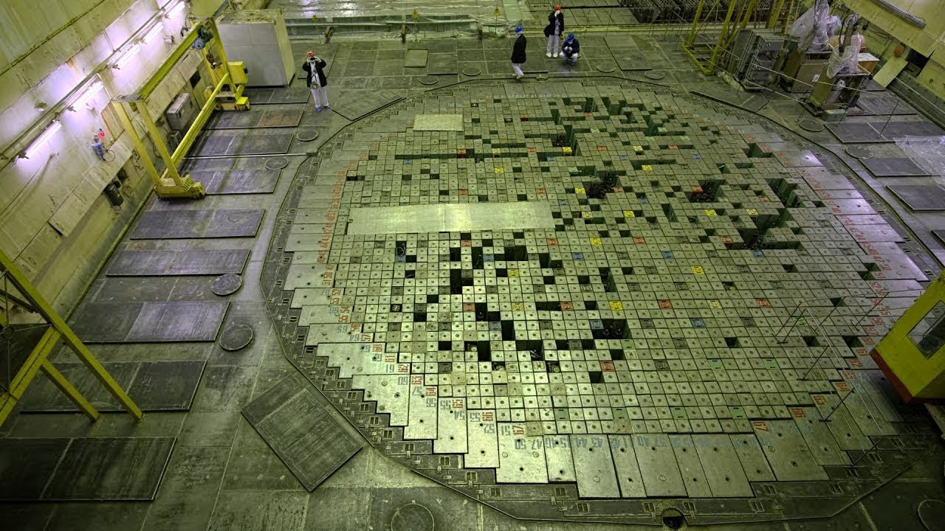
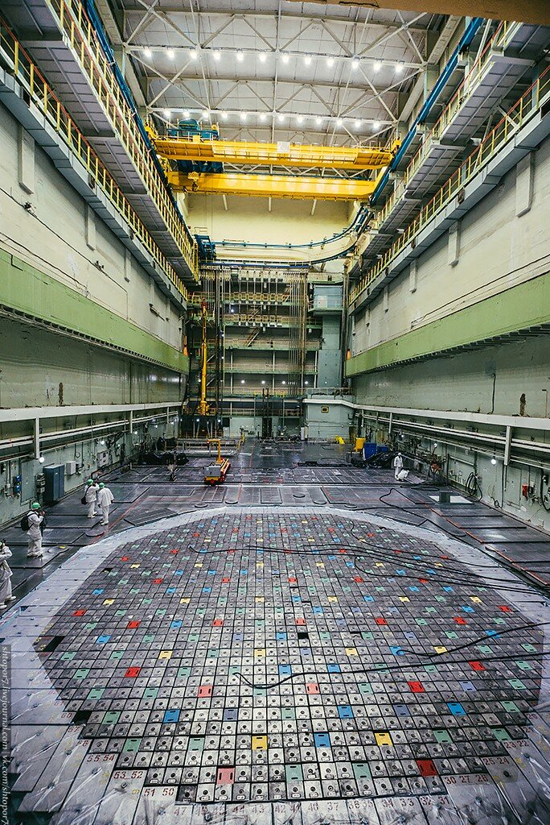
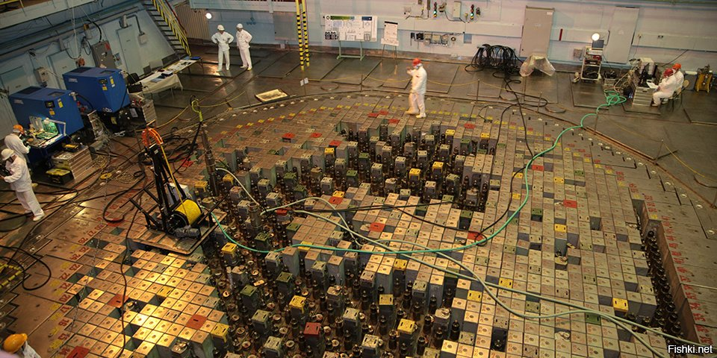
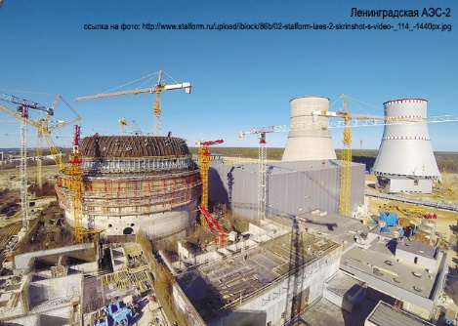
Tutorial 13. ENERGY INVESTMENT OBJECTS
Part 2. Nuclear energy
INVESTMENT DESIGN INNOVATION IN
THE ENERGY SYSTEM

Slide 7
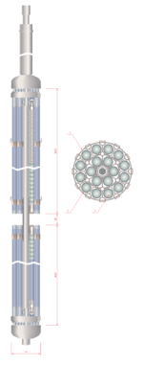
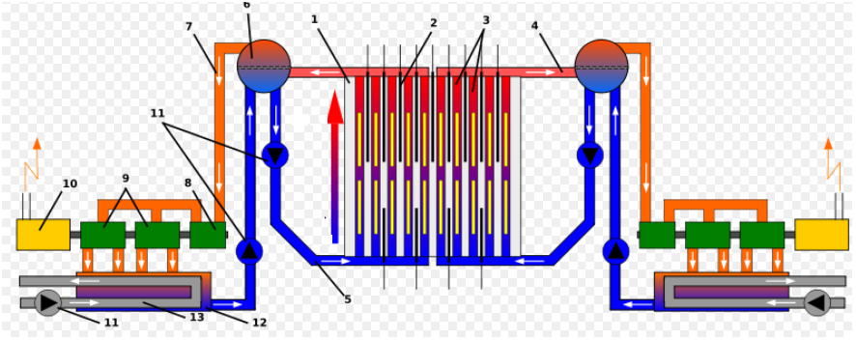
Tutorial 13. ENERGY INVESTMENT OBJECTS
Part 2. Nuclear energy
INVESTMENT DESIGN INNOVATION IN
THE ENERGY SYSTEM
HPCR reactor fuel assembly:
1 – Spacer
2 – Fuel rods shell
3 – Nuclear fuel tablets
1. Graphite retarder
2. The rods of the control and protection
3. Tech
nological channels
4. Steam
5. Water
6. Separator drum
7. Dry steam
8. High-pressure turbines
9. Low pressure turbine
10. Electric generator
11. Circulation pumps
12. Cooler (condenser)
13. Auxiliary water circuit

Slide 8
Tutorial 13. ENERGY INVESTMENT OBJECTS
Part 2. Nuclear energy
INVESTMENT DESIGN INNOVATION IN
THE ENERGY SYSTEM
When designing the HPCR power units, due to the imperfection of the calculation methods, a non-optimal channel grid step was chosen. As a result, the reactor was somewhat over-slowed, which led to positive values of the steam reactivity coefficient in the working area, exceeding the proportion of delayed neutrons. Before the accident at the Chernobyl nuclear power plant, it was believed that despite the positive vapor reactivity coefficient, this value changes sign as the vapor content increases. However, as it turned out after the Chernobyl accident, this is not the case. Subsequently, this disadvantage was eliminated by using a higher-enriched fuel with a burn-out absorber (erbium oxide).
In each fuel channel, a cassette is installed, consisting of two fuel assemblies – the lower and upper. Each assembly includes 18 rod fuel rods. The fuel element shell is filled with uranium dioxide tablets. According to the initial project, the enrichment of uranium-235 was 1.8 %, but, as the experience of operating HPCR accumulated, it turned out to be advisable to increase the enrichment. The increase in enrichment, combined with the use of a burn-out absorber in the fuel, made it possible to increase the controllability of the reactor, increase safety and improve its economic performance. Currently, the transition to fuel with an enrichment of 3.0% is underway.

Slide 9
Tutorial 13. ENERGY INVESTMENT OBJECTS
Part 2. Nuclear energy
INVESTMENT DESIGN INNOVATION IN
THE ENERGY SYSTEM
The HPCR reactor operates on a single-circuit circuit. The circulation of the coolant is carried out in a multiple forced circulation circuit. In the core, the water cooling the fuel rods partially evaporates and the resulting steam-water mixture enters the separator drums. In the drum separators, the steam is separated, which enters the turbine unit. The remaining water is mixed with the feed water and fed to the reactor core using the main circulation pumps (MCP). Separated saturated steam (temperature 285°C) at a pressure of 70-65 kgf/cm² is supplied to two turbogenerators with an electric capacity of 500 MW each. The spent steam is condensed, after which, passing through regenerative heaters and a deaerator, it is fed by feed pumps in a multiple forced circulation circuit.

Slide 10
Tutorial 13. ENERGY INVESTMENT OBJECTS
Part 2. Nuclear energy
INVESTMENT DESIGN INNOVATION IN
THE ENERGY SYSTEM
HPCR -1000 Generation 3+/RBMK-1500
The design of the graphite masonry of the reactor, which has the shape of an octahedron in cross-section. By reducing the volume of graphite, the ratio of the fuel fraction to the moderator fraction changes, which has a significant effect on the steam reactivity coefficient. As a result, the reactor can operate with a minimum operational reserve (OR), which further increases its economic efficiency.
HPCR -1500 Reactor power while maintaining the HPCR -1500 design. This is achieved by increasing the rate of heat removal from the fuel element.
All together, this allows you to maintain the same dimensions and overall design of the reactor.

Slide 11
Tutorial 13. ENERGY INVESTMENT OBJECTS
Part 2. Nuclear energy
INVESTMENT DESIGN INNOVATION IN
THE ENERGY SYSTEM
Dignities
1. Reduced water pressure in the primary circuit compared to the hull WWER (PWR by IAEA);
2. Thanks to the channel design, there is no expensive housing;
3. No expensive and complex steam generators;
4. There are no fundamental restrictions on the size and shape of the core (for example, it can be in the form of a parallelepiped);
5. Independent control and protection system circuit;
6. Extensive opportunities for regular monitoring of the state of the core components (for example, pipes of technological channels) no need to shut down the reactor and high maintainability;
7. Low "parasitic" neutron absorption in the core (more favorable neutron balance), as a result - more complete use of nuclear fuel;
8. Fuel replacement without stopping the reactor due to the independence of the channels from each other (in particular, increases Cumulative coefficient (installed capacity utilization factor);
9. The possibility of developing radionuclides for technical and medical purposes, as well as radiation doping of various materials;
10. The absence (in comparison with the hull WWER) of the need for boron regulation;
11. Ability to operate a reactor with a low OR-operational reactivity reserve of the HPCR-1000 generation 3+
12. Cheaper fuel due to the lower degree of enrichment, although the fuel load is much higher (in the general fuel cycle, the reprocessing of spent fuel from WWER is used);
13. Channel-by-channel regulation of coolant flow through the channels, which allows monitoring the thermal reliability of the core.

Slide 12
Tutorial 13. ENERGY INVESTMENT OBJECTS
Part 2. Nuclear energy
INVESTMENT DESIGN INNOVATION IN
THE ENERGY SYSTEM
Disadvantages
1. A large number of pipelines and various auxiliary subsystems require a large number of highly qualified personnel;
2. The need for channel-by-channel flow control, which may lead to accidents associated with the termination of the flow of coolant through the channel;
3. Higher load on operational personnel compared to WWER, associated with a large number of components (for example, shut-off and control valves);
The accident at the power units with HPCR
*Leningrad NPP (near St. Petersburg), Russia
**Chernobyl NPP, Ukraine (near the border with Belarus)
The most serious incidents at nuclear power plants with HPCR reactors:
1975-rupture of one channel at the first unit of the Leningrad NPP;
1982-rupture of one channel on the first block of the Chernobyl NPP;
1986-accident with a massive rupture of channels at the fourth block of the Chernobyl NPP;
1991-fire in the engine room of the second unit of the Chernobyl NPP;
1992-rupture of one channel on the third block of the Leningrad NPP;

Slide 13
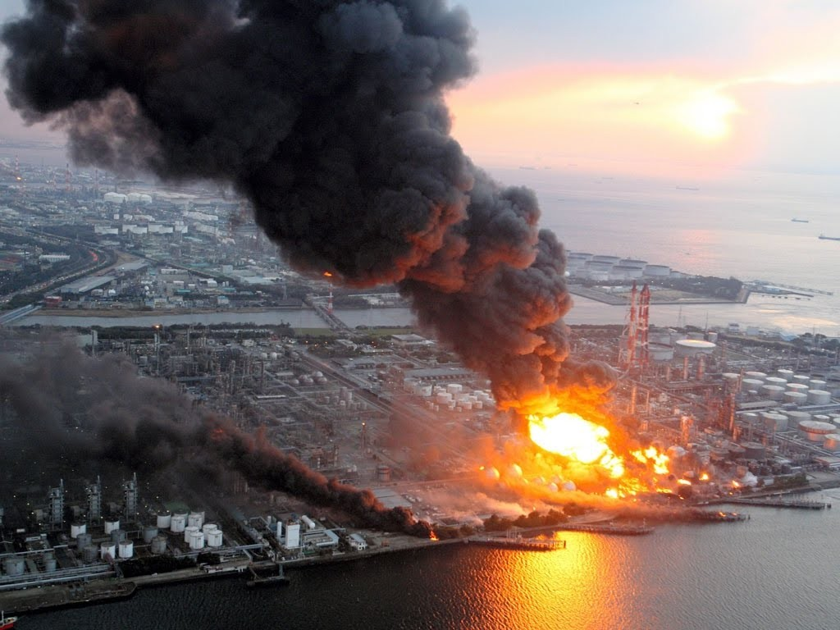
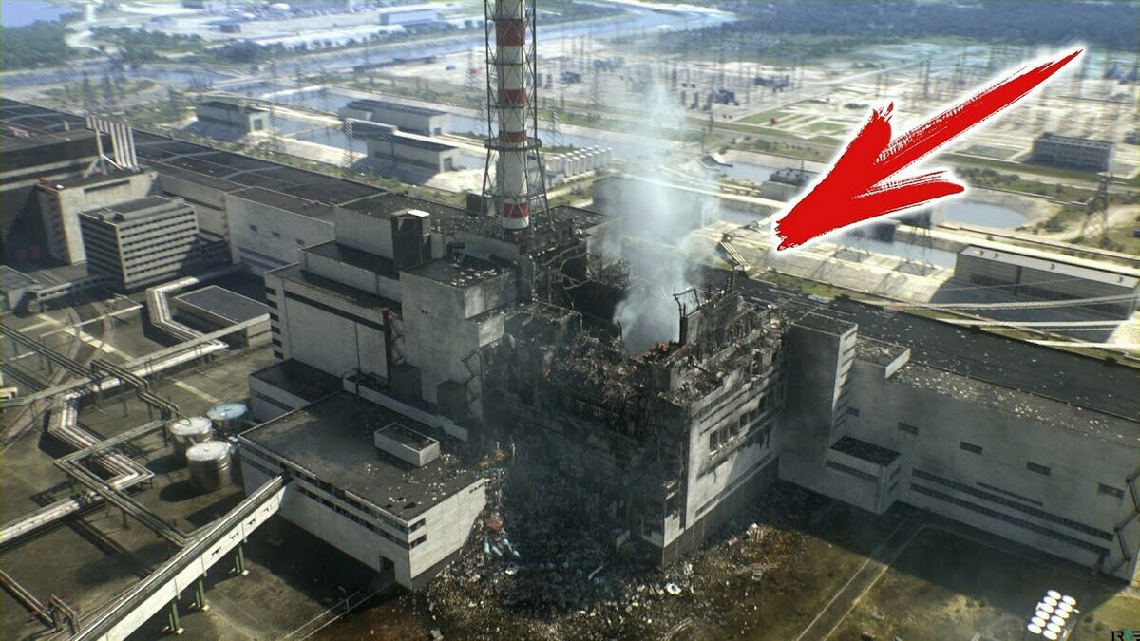
Tutorial 13. ENERGY INVESTMENT OBJECTS
Part 2. Nuclear energy
INVESTMENT DESIGN INNOVATION IN
THE ENERGY SYSTEM
Major nuclear power plant accidents
Сconsequences of the explosion
at the Chernobyl NPP
Fire on Fucusima-1 NPP
I strongly recommend you to study the the accidents at Fukushima-1 and the Chernobyl NPP - the biggest accidents in the history of mankind

Slide 14
Tutorial 13. ENERGY INVESTMENT OBJECTS
Part 2. Nuclear energy
INVESTMENT DESIGN INNOVATION IN
THE ENERGY SYSTEM
Condition
NPP | Number of reactors | Type reactor | Status NPP | Reactor generating capacity (MW)
Chernobyl NPP | 6 | HPCR -1000 | Stopped | 1 000
Ignalinsk NPP | 4 | HPCR -1500 | Stopped | 1 500
Kursk NPP | 4 | HPCR -1000 | Active | 1 000
Lenindrad NPP | 4 | HPCR -1000 | Active | 1 000
Smolensk NPP | 3 | HPCR -1000 | Active | 1 000

Slide 15
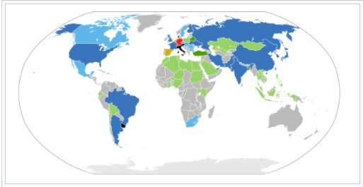
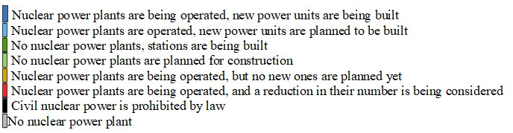
INVESTMENT DESIGN INNOVATION IN THE ENERGY SYSTEM
13.7 Global nuclear power industry

Slide 16
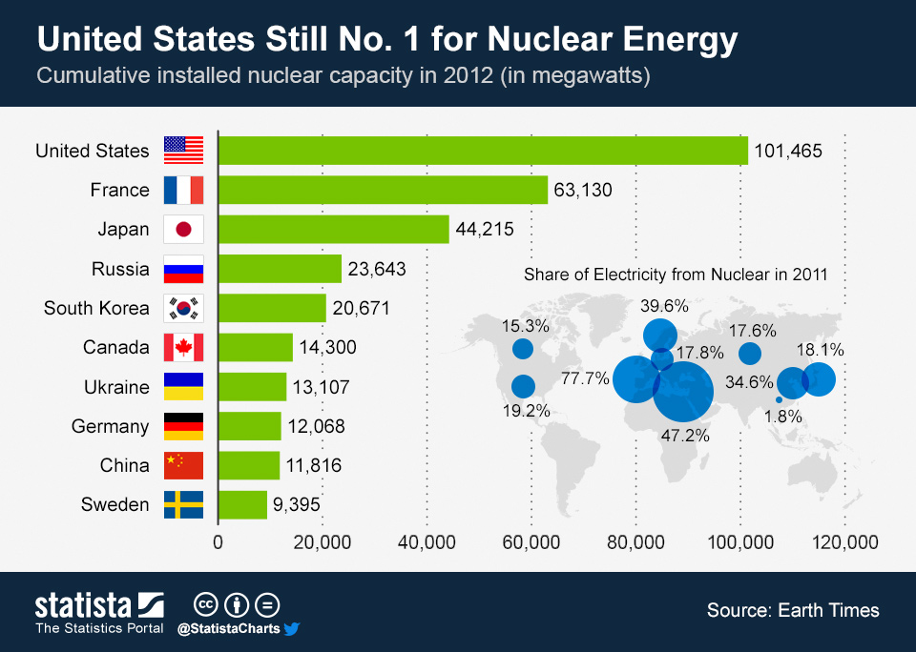
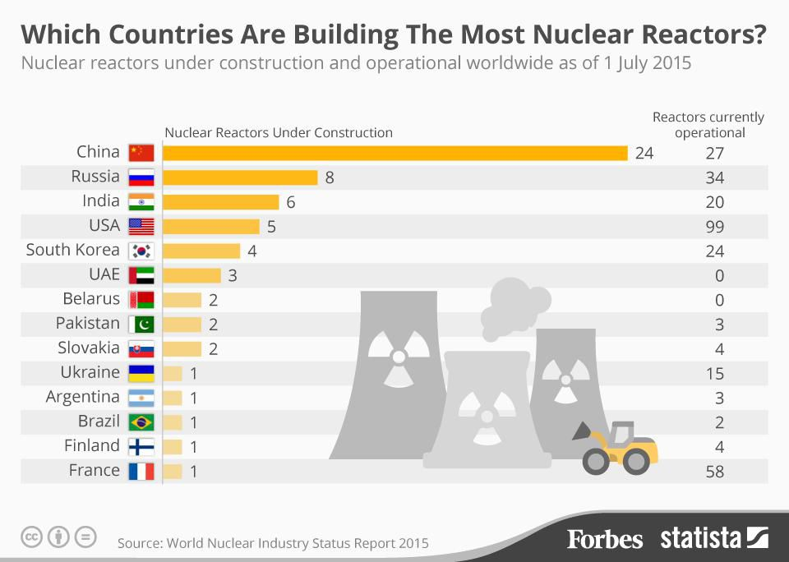
Tutorial 13. ENERGY INVESTMENT OBJECTS
Part 2. Nuclear energy
INVESTMENT DESIGN INNOVATION IN
THE ENERGY SYSTEM

Slide 17
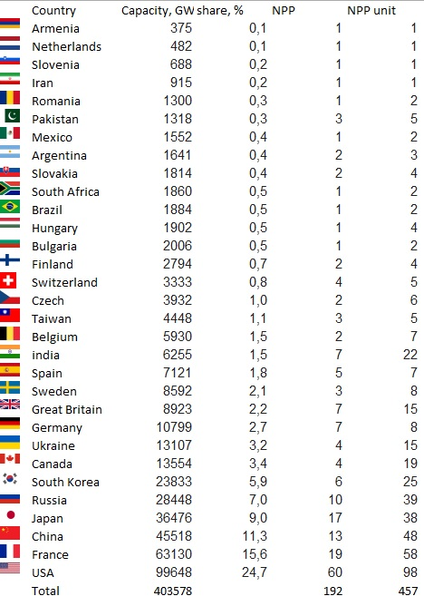
Tutorial 13. ENERGY INVESTMENT OBJECTS
Part 2. Nuclear energy
INVESTMENT DESIGN INNOVATION IN
THE ENERGY SYSTEM
Global nuclear power industry (data for 2018)
Capacity | Country
GW > 10 | USA • France • Japan • Russia • Germany • South Korea • Ukraine • Canada • United Kingdom • China
GW > 2 | Sweden • Spain • Belgium • Taiwan • India • Czech Republic • Switzerland • Finland
GW > 1 | Bulgaria • Brazil • South Africa • Hungary • Slovakia • Romania • Mexico
GW < 1 | Argentina • Slovenia • Netherlands • Pakistan • Armenia • Iran • Belarus

Slide 18
Tutorial 13. ENERGY INVESTMENT OBJECTS
Part 2. Nuclear energy
INVESTMENT DESIGN INNOVATION IN
THE ENERGY SYSTEM
NPP China
Companies
China National Nuclear Corporation
• China General Nuclear Power Group
• State Nuclear Power Technology Corporation
• China Nuclear International Uranium Corporation
Today, the output of China's nuclear power plants is 11.3 % or 45.5 GW of the total energy output. This is a confident third place. Today, China has displaced nuclear power producers such as Russia and Japan! This phenomenon is a consequence of the fact that the Chinese production capacity is No. 1 in the world. Naturally, such volumes require electrical energy in such volumes. In addition, China is also trying to improve the air quality in the region, reduce emissions of harmful and toxic substances, and prevent global warming as the best alternative to coal-fired power plants in China.
In 2020-2021, the total number of active and under construction capacities is more than 80 kW, and in the future, the total capacity of nuclear power plants will reach 200 GW by 2030 and 400 GW by 2050.

Slide 19
Tutorial 13. ENERGY INVESTMENT OBJECTS Part 2. Nuclear energy
INVESTMENT DESIGN INNOVATION IN THE ENERGY SYSTEM
Summary table of nuclear power plants in China
Nuclear power plant | operational reactors |  | reactors under construction |  | reactors planned |  | total
 | units | net capacity(MW) | units | net capacity (MW) | units | net capacity (MW) | units | net capacity (MW)
Bailong | N/A |  | N/A |  | 6 | 6,600 | 6 | 6,600
Huizhou/Taipingling | N/A |  | 2 | 2,100 | N/A |  | 2 | 2,100
Lufeng (Shanwei) | N/A |  | N/A |  | 2 | 2,200 | 2 | 2,200
Pengze | N/A |  | N/A |  | 2 | 2,200 | 2 | 2,200
San'ao | N/A |  | 1 | 1,000 | 5 | 5,000 | 6 | 6,000
Shidao Bay (Shidaowan) | N/A |  | 2 | 1,600 | 1 | 1,400 | 3 | 3,000
Taohuajiang | N/A |  | N/A |  | 4 | 4,400 | 4 | 4,400
Xianning | N/A |  | N/A |  | 2 | 2,200 | 2 | 2,200
Xiapu | N/A |  | 1 | 600 | 1 | 600 | 2 | 1,200
Xudabao | N/A |  | N/A |  | 4 | 4,400 | 4 | 4,400
Zhangzhou | N/A |  | 2 | 2,100 | 2 | 2,100 | 2 | 2,100
CEFR | 1 | 20 | N/A |  | N/A |  | 1 | 20
Changjiang | 2 | 1,220 | N/A |  | 2 | 1,220 | 4 | 2,440
Daya Bay (Dayawan) | 2 | 1,888 | N/A |  | N/A |  | 2 | 1,888
Fangchenggang | 2 | 2,000 | 2 | 2,100 | 2 | 2,100 | 6 | 6,200
Fangjiashan | 2 | 2,000 | N/A |  | N/A |  | 2 | 2,000
Haiyang | 2 | 2,200 | N/A |  | 6 | 6,600 | 8 | 8,000
Sanmen | 2 | 2,314 | N/A |  | 2 | 2,314 | 4 | 4,628
Taishan | 2 | 3,320 | N/A |  | N/A |  | 2 | 3,320
Fuqing | 4 | 4,000 | 2 | 2,100 | N/A |  | 6 | 6,100
Hongyanhe | 4 | 4,244 | 2 | 2,000 | N/A |  | 6 | 6,244
Ling Ao | 4 | 3,914 | N/A |  | N/A |  | 4 | 3,914
Ningde | 4 | 4,072 | N/A |  | 2 | 2,100 | 6 | 6,172
Tianwan | 5 | 4,960 | 1 | 1,000 | 2 | 2,200 | 8 | 8,230
Yangjiang | 6 | 6,090 | N/A |  | N/A |  | 6 | 6,090
Qinshan | 7 | 4,110 | N/A |  | N/A |  | 7 | 4,110
Total: | 49 | 46,352 | 15 | 14,600 | 43 | 45,534 | 107 | 106,486
PWR | 46 |  |  |  | 42
PHWR | 2 |  |  |  | 0
FBR | 1 |  |  |  | 0
HTGR | 0 |  |  |  | 1

Slide 20
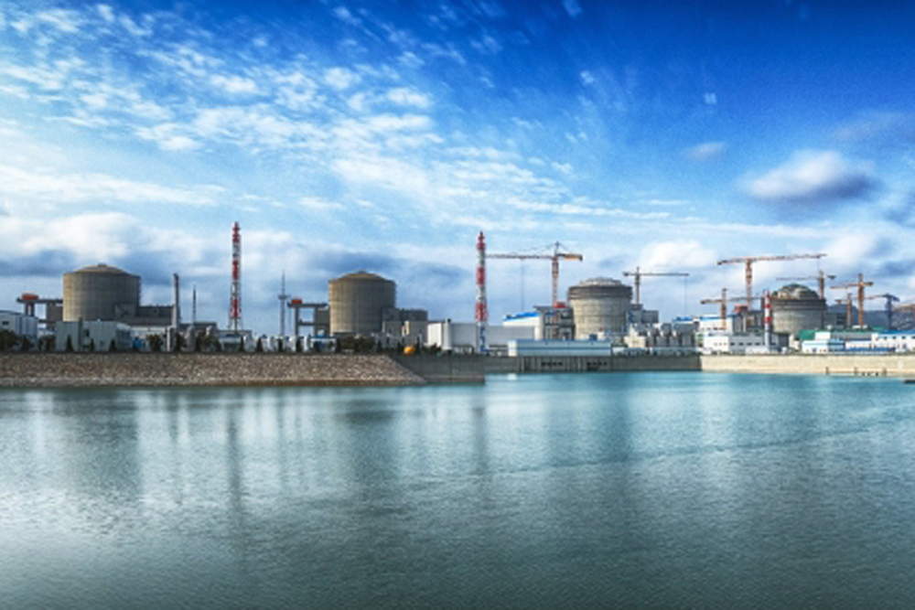
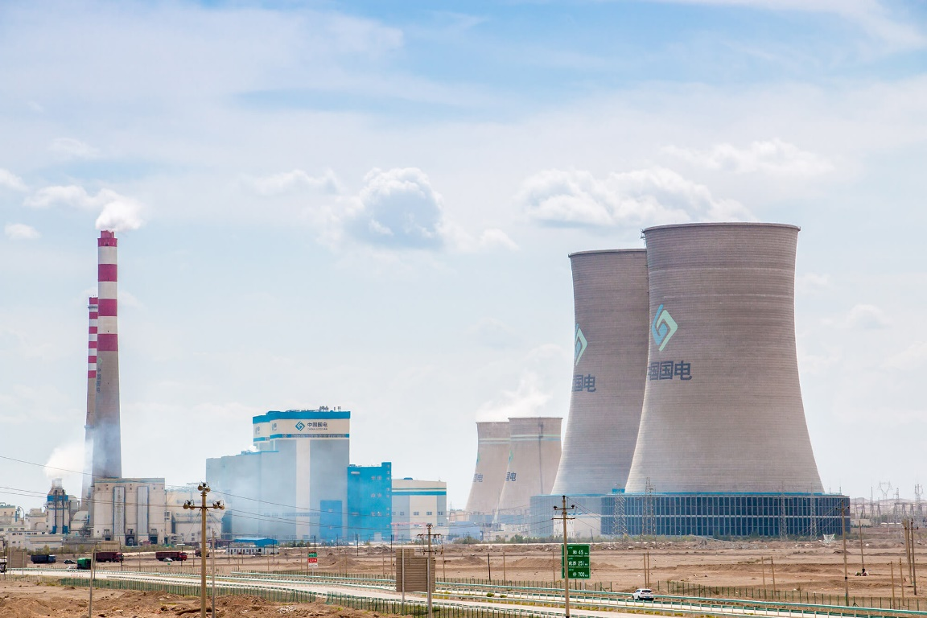
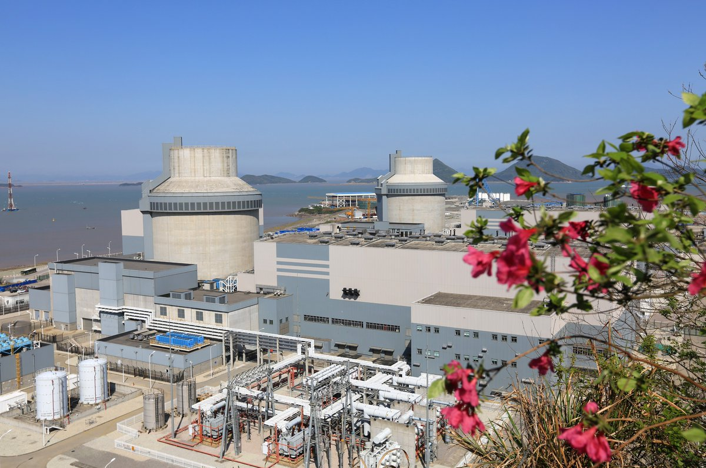
Tutorial 13. ENERGY INVESTMENT OBJECTS
Part 2. Nuclear energy
INVESTMENT DESIGN INNOVATION IN
THE ENERGY SYSTEM
Sanmen NPP
Construction of 7-8 power units of the Taiwan NPP
Taishan NPP

Slide 21
Tutorial 13. ENERGY INVESTMENT OBJECTS
Part 2. Nuclear energy
INVESTMENT DESIGN INNOVATION IN
THE ENERGY SYSTEM
Today, the output of China's nuclear power plants is 11.3 % or 45.5 GW of the total energy output. This is a confident third place. Today, China has displaced nuclear power producers such as Russia and Japan! This phenomenon is a consequence of the fact that the Chinese production capacity is No. 1 in the world. Naturally, such volumes require electrical energy in such volumes. In addition, China is also trying to improve the air quality in the region, reduce emissions of harmful and toxic substances, and prevent global warming as the best alternative to coal-fired power plants in China.
In 2020-2021, the total number of active and under construction capacities is more than 80 kW, and in the future, the total capacity of nuclear power plants will reach 200 GW by 2030 and 400 GW by 2050.

Slide 22
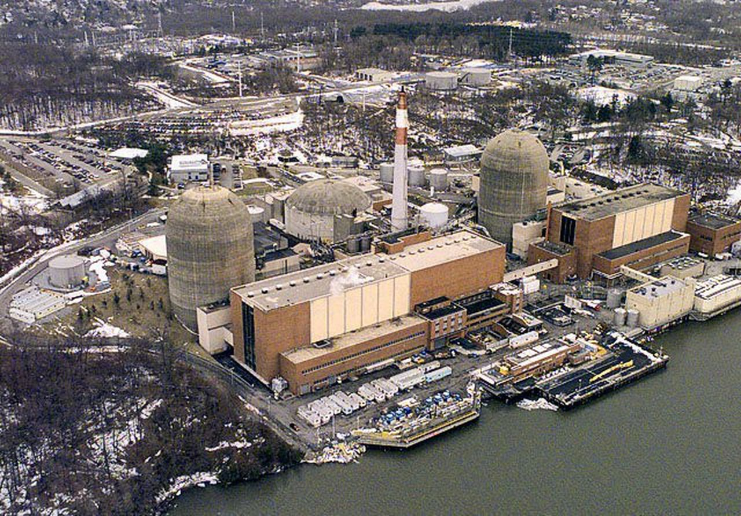
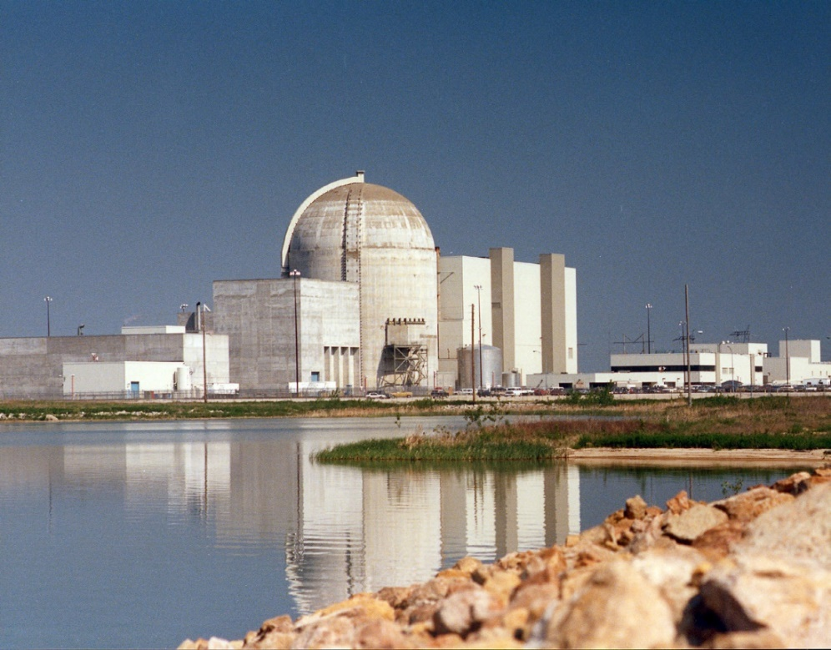
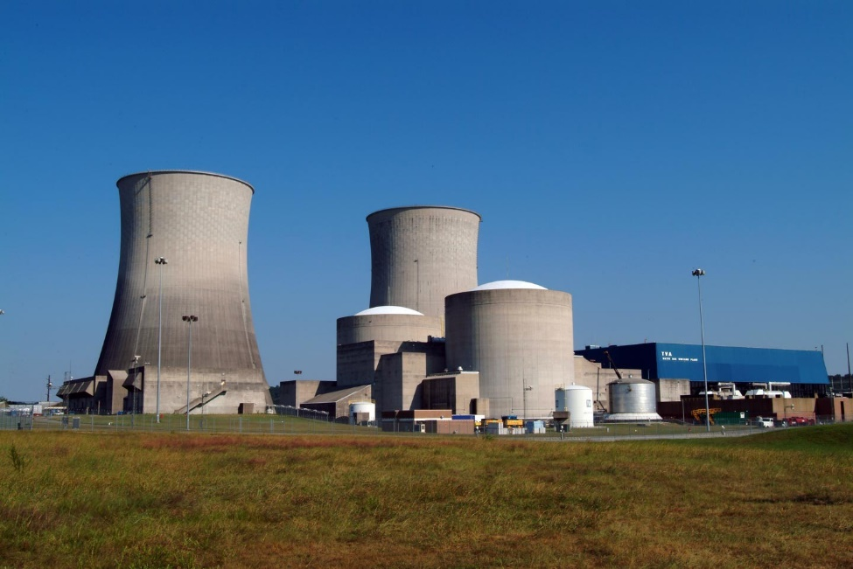
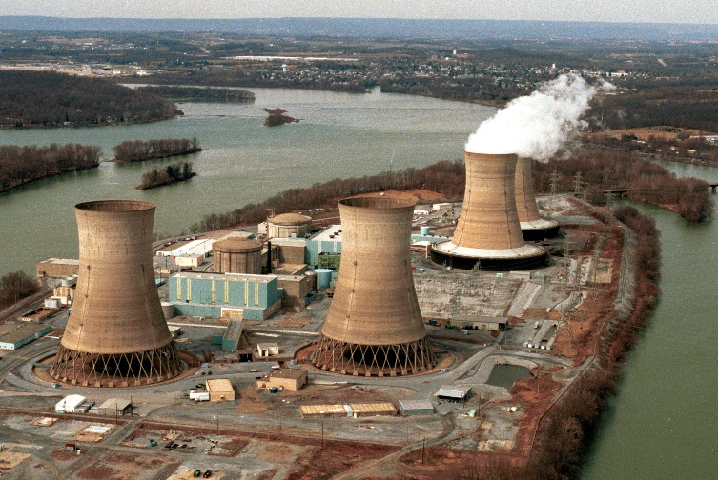
Tutorial 13. ENERGY INVESTMENT OBJECTS
Part 2. Nuclear energy
INVESTMENT DESIGN INNOVATION IN
THE ENERGY SYSTEM
USA Nuclear power plant
Nuclear power plants (NPPs) in the United States use only these two types of reactors. There are a total of 98 nuclear reactors in the United States (64 PWR and 34 BWR water-water and boiling water reactors), together they provide about 30% of the electricity consumption in the United States. Unlike Russia, France, and the United Kingdom, the United States does not currently reprocess spent nuclear fuel.
Wolf Creek NPP
NY NPP Labsy
NPP Tennessee. First NPP in 21century
NPP 3 mile-island NPP. Closed after incident NPP

Slide 23
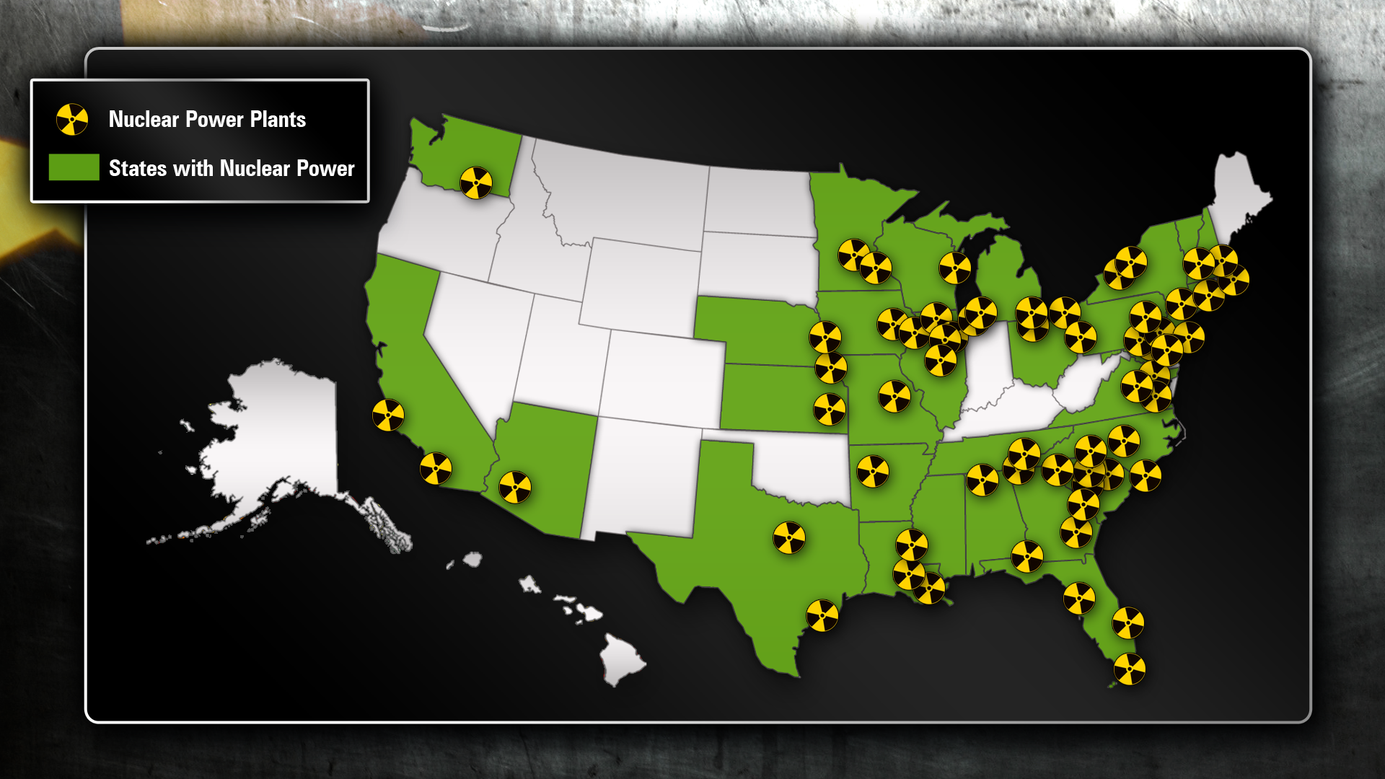
Tutorial 13. ENERGY INVESTMENT OBJECTS
Part 2. Nuclear energy
INVESTMENT DESIGN INNOVATION IN
THE ENERGY SYSTEM
USA NPP

Slide 24
INVESTMENT DESIGN INNOVATION IN THE ENERGY SYSTEM
13.8 Fast breeder Neutron Reactor
Breeder-a nuclear reactor that allows you to produce nuclear fuel in an amount that exceeds the needs of the reactor itself.
Projected percentage distribution of nuclear power plants
year | 2000 | 2010 | 2020 | 2030 | 2060
Breeder | 0 | 0 | 0 | 15 | 50
PWR 3+ | 0 | 5 | 30 | 74 | 25
HTGR H–production | 0 | 0 | 0 | 1 | 20
FNR | 0 | 0 | 0 | 0 | 0
BWR | 30 | 35 | 30 | 0 | 0
HPCR | 15 | 10 | 5 | 5 | 0
PWR | 55 | 50 | 35 | 5 | 5
* FNR-fast netron sodium reactor
** HTGR – High-temperature gas reactor with a hydrogen station (hydrogen production)

Slide 25
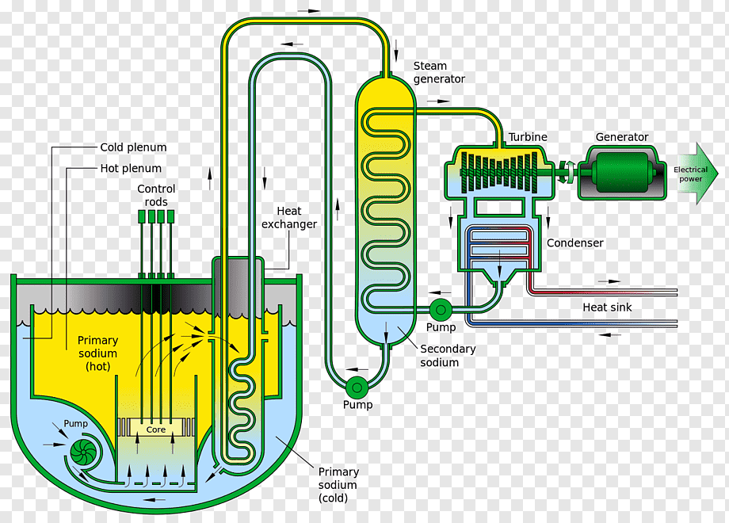
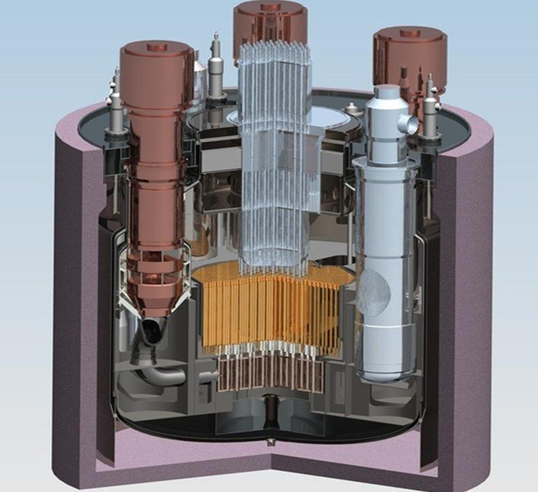
Tutorial 13. ENERGY INVESTMENT OBJECTS
Part 2. Nuclear energy
INVESTMENT DESIGN INNOVATION IN
THE ENERGY SYSTEM
Breeder

Slide 26
Tutorial 13. ENERGY INVESTMENT OBJECTS
Part 2. Nuclear energy
INVESTMENT DESIGN INNOVATION IN
THE ENERGY SYSTEM
Fast neutrons are absorbed by the U-238 nuclei to form easily split plutonium nuclei, potentially suitable for energy production. This is used in breeder reactors (breeders). Here, plutonium-239 is used as a fissionable material, which gives 2-3 neutrons at each decay. One of them is spent on maintaining the chain reaction, and the rest are absorbed by uranium-238 to form plutonium-239, that is, a new nuclear fuel, so the reactor seems to "hatch" new fuel for itself, and in the ideal case-even more than it consumes. This mechanism is implemented on a small scale in other types of reactors. U-238 is much more accessible than other isotopes, and if in the coming centuries it is not possible to find safer energy resources, breeders, despite the great technical problems in their construction, are likely to become an important element of the world's energy. With the help of breeder technology, it is possible to generate energy from U-238, which is useless for other reactors, turning it into fissionable material, and thus use natural uranium 60 times more efficiently than usual. The conversion of U-238 to plutonium is better under the influence of fast neutrons than slow ones. Fast neutron breeders use fast neutrons for fission, so for normal operation, the fuel must have an increased content of fissionable material, so the fuel elements in such reactors contain 20-30% plutonium and only 70-80% U-238. As a result, fast breeders are loaded with 10 times more fissionable material than in the previously described types of reactors, which, of course, entails all sorts of difficulties, dangers and problems. After such a preface, it is easy to give a description of the fast neutron breeder. The reactor itself consists of fuel elements, which generate energy, and reproducing elements, in which new fissionable material is formed. Due to the high content of this material, the level of heat transfer is also very high. Therefore, the reactor is cooled with liquid sodium, which has a very high thermal conductivity, but, unlike water, does not perform the function of a neutron moderator. So, the primary sodium circuit removes heat from the core and transfers it to the secondary sodium circuit, which turns water into steam that turns turbines to generate electricity.

Slide 27

Energy investment objects
Topic 12. Traditional energy.
INVESTMENT DESIGN INNOVATION IN
THE ENERGY SYSTEM
Test
Classification of NPP
IAEA Classification
Pressurized water reactors (PWR)
Boiling water reactors (BWR)
High-Power Channel Reactor (HPCR)
Breeder

